Slide 1
Notes:
All of us have encountered a situation where code works on developer system but doesn’t work on testing environment. Docker at a very basic level resolves this issue of working on one platform and not working on another. However there is much more to docker. Docker is present in the entire project workflow but its main use is in deployment.

Slide 2
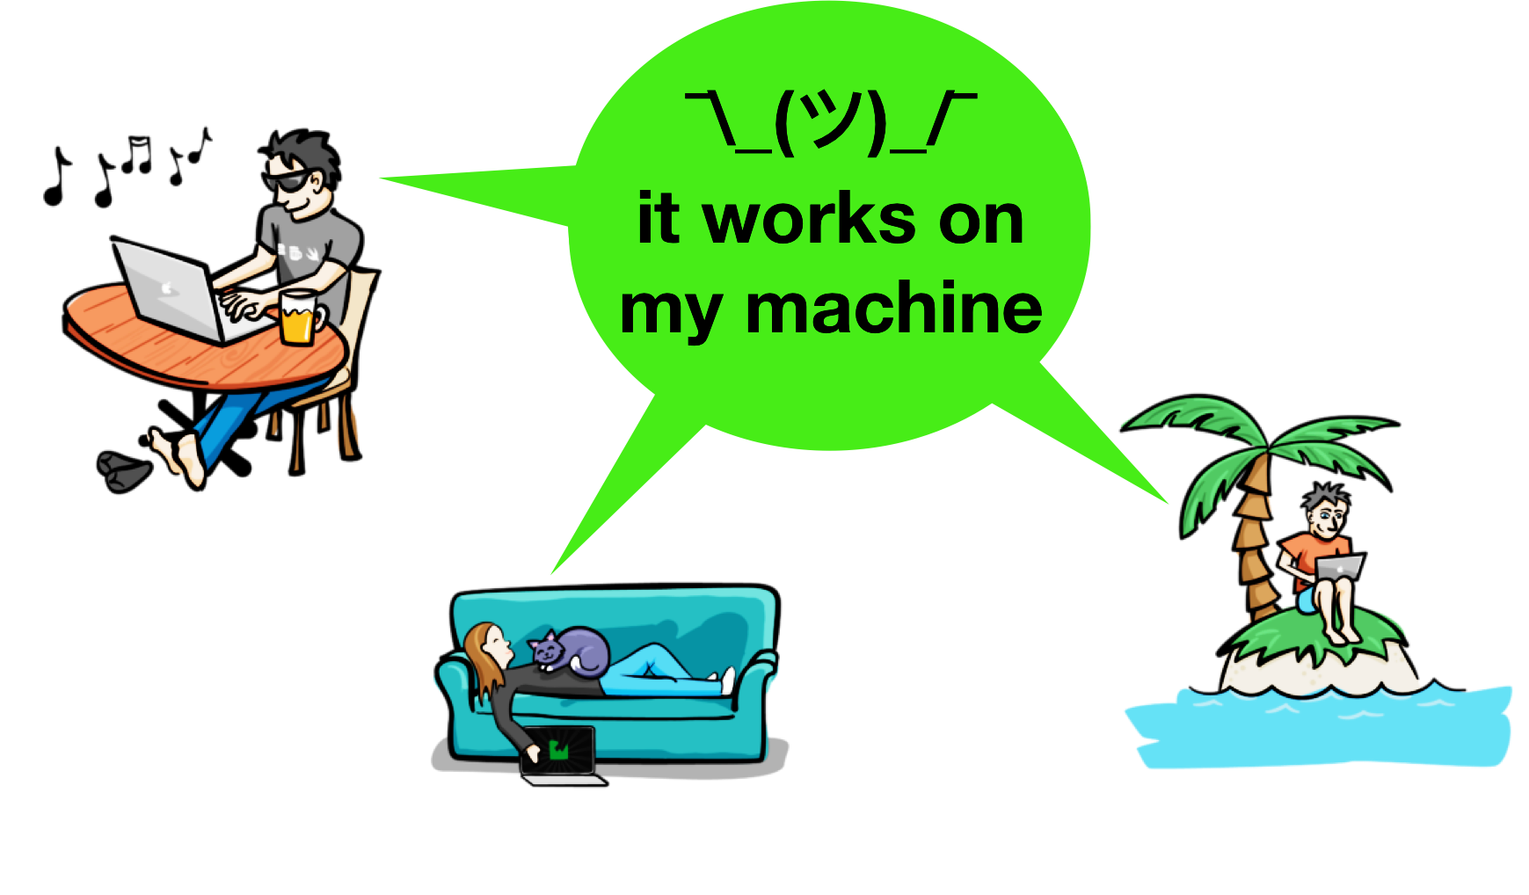
Keep calm, it works on all machines

Slide 3
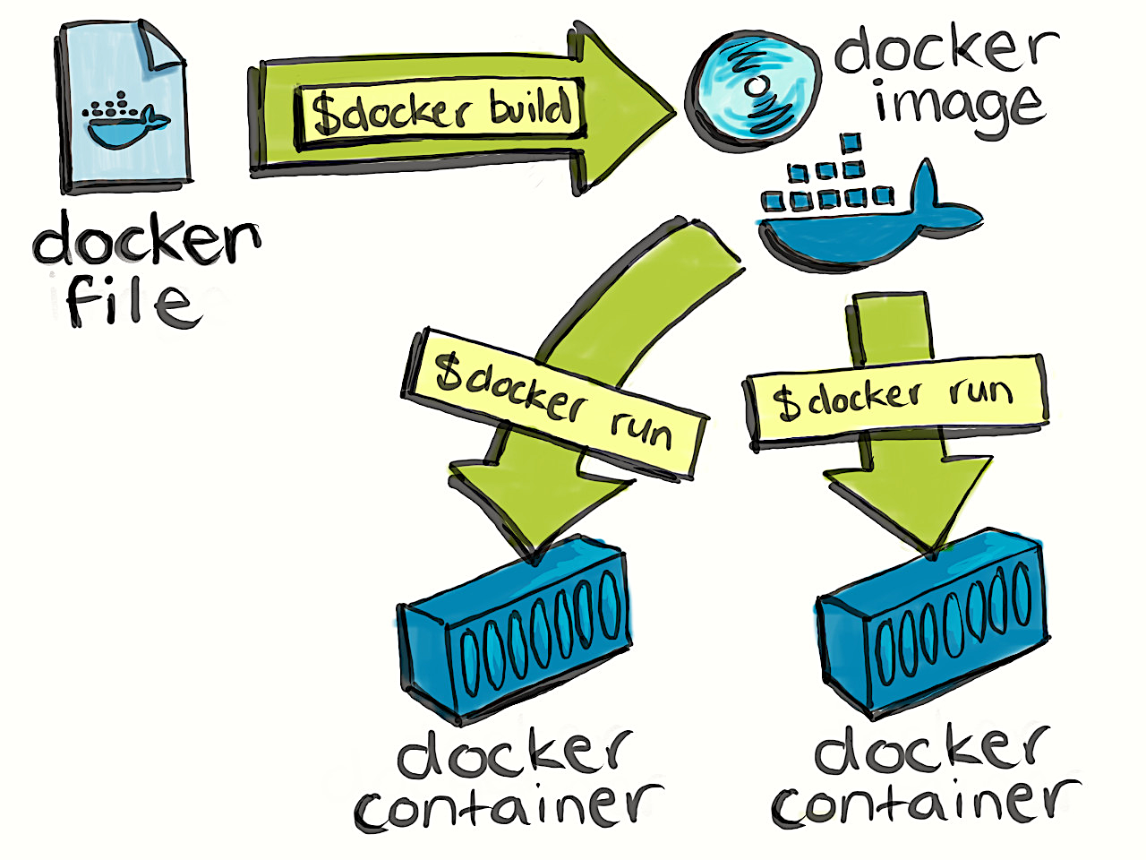
Notes:
Dockerfile – steps to create a docker image, it’s like a recipe with all ingredients and steps necessary in making your disk.
Docker file can be used to create docker image.

Slide 4
Docker image has application requirements and dependencies
Notes:
In the doocker image you’ll have application requirements and dependencies.
When you run docker image, you get docker container.
Docker images can also be stored in cloud repository, docker hub, you can also store docker images in your git repo.
These images can be pulled to create container in any environment.

Slide 5
Containers are running instance of docker image
Notes:
Containers allows us to package up an application with all of the parts it needs such as libraries and other dependancies, and docker ship it all out as one package.
With docker you test your application insider a container and ship it inside a container. This means the environment which you test is identical to the one which the app will run in production.

Slide 6
Virtualisation v/s Containerisation
Containers are light weight alternatives to VMs
Notes:
Virtualisation –
Hypevisor is used to create and run virtual machines. Using Hyper-v we can create multiple VM’s on host operating system. VM has their own OS and doesn’t use host OS so there can be an overhead on host platform VM – resource allocation is fixed and doesn’t change as per application needs.
Containterization:
Here we have container engine and instead of separating OS we have containers, where we have application and all its dependencies and it’ll use the host OS. In this case space, memory and other resources are not fixed, it’ll be taken as per application needs.
If you want to learn more about docker - https://labs.play-with-docker.com/

